Slide 1
Pittsford Robotics
Programming 2010

Slide 2
Duties
Write a program to control the robot
Work closely with mechanical and electrical teams
Important to know what hardware will be used
Make code as reusable as possible
Separation of logic
Properly formatted documentation

Slide 3
Program Specifics
Tell the robot what to do, and when to do it
Allows the robot to respond to inputs
e.g., Joysticks controlling movement
Allows function without operator control

Slide 4
Tools
Classmate PC
Netbook which interfaces with robot
Netbeans, Eclipse
Special programs (IDEs) which make coding easier
Subversion
Version control system which allows us to work from multiple computers, or at home if necessary
Java
Language we wrote in

Slide 5
Kicking
Check if the trigger is pressed
Make sure the kicker has returned to default position
Release the latch, firing the pressurized piston
Wait a bit, then begin to retract the kicker
Start pressurizing the kicker

Slide 6
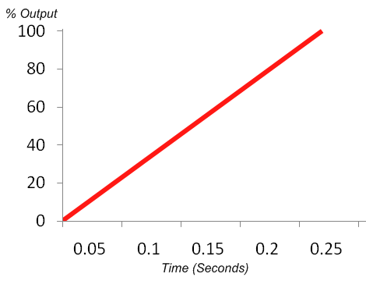
“Ramping”
Ramping is the process of deliberately accelerating at a relatively slow, controlled speed
Saves drive system from damage

Slide 7
Autonomous Mode
Read Switches
Determine which of many preloaded programs to run
Perform Maintenance
Simple, but essential things like repressurizing the kicker’s piston
Uses “Dead Reckoning” to carry out instructions
Run Program

Slide 8
Team Members
Eric Vernon
Ben Lowenstein
Chris Cheng

